Slide 1
System Project
Week - 03
SUPERVISOR
Kazi Saeed Alam
Assistant Professor
Department of Computer Science and Engineering
Prothom Ghosh (2107097)
Md. Rubayet Nabil (2107073)

Slide 2




SUMMARY
Weekly Update
Authentication
Admin and Simulation
Home Page
Database Design
Login Page UI
Admin Dashboard UI
Landind Page UI
Vehicle Database
Signup Page UI
Driver Database
Violation Database
Camera Database
2

Slide 3

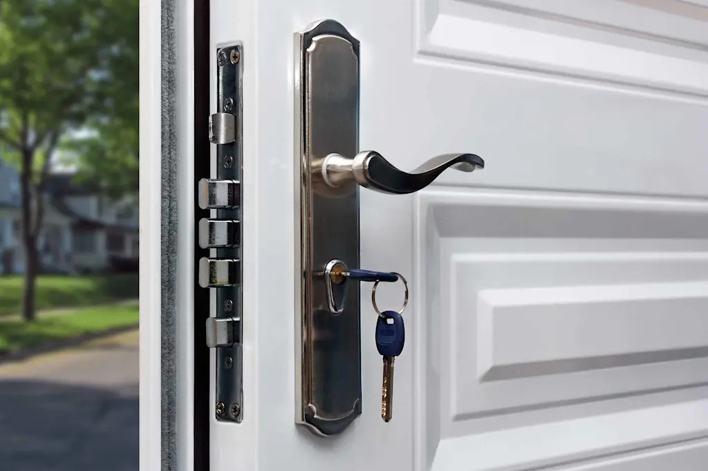


DETAILS
Authentication
Sign in Page
Login with vehicle ID or Driver ID
Option to register a vehicle or Driver
Sign up Page
Register as Driver
Register as a Vehicle or Owner
3

Slide 4



Details
Admin and Simulation
Dashboard Page
Add or remove a vehicle or Driver
Change ownership and update data
Add camera location
See Traffic Records
Filter records by time
Filter records by location
Find Traffic Hotspot
Find Accident Hotspot
Violations
Notify recent violations
See Details information
Simulation Page
Simulate violations
8

Slide 5

DETAILS
Home Page
Vehicle Dashboard
Vehicle information
Registration details
Recent Traffic records
Unpaid Fines
3

Slide 6
Reflections & Growth
Team A
Database Design
Vehicle Database
Violation and Records database
Stores registered vehicle and owner details
Unique identification using vehicle ID and number plate
Logs camera-detected vehicle movements
Stores violations, fines, and payment status
Driver Database
Camera Database
Links drivers to vehicles over time
Tracks assignment duration and driver credit score
Stores camera locations with GPS data
Enables route and distance analysis between locations
12

Slide 7

DataSEts
Team A
What We Found
Bangladeshi Vehicle license plate (YOLO format)
https://www.kaggle.com/datasets/sifatkhan69/bangladeshi-vehicle-
3.5k+ image
10

Slide 8
Concept Development
Team A
Stolen Car Tracking
Weighted Graph
Detection
Notify Law Enforcement
Camera locations are kept as a weighted graph where nodes are cameras and edges are paths to cameras
Flag or alert the system if the stolen car is detected
Track Stonlen Car
AI Based Tracking
Keep a separate database for
Stolen car
car involved in crime
Track the car and speed. then determine which adjacent node the car will pass using AI.
7

Slide 9
Thank You

